Slide 1






Disaster Preparedness
Basic Disaster Preparedness
August 19, 2018

Slide 2



Agenda
What is a disaster?
How should you prepare before?
What do you do during and after an event?
What is your community doing to prepare?
We CERT!
Basic Disaster Preparedness

Slide 3

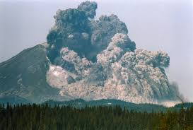
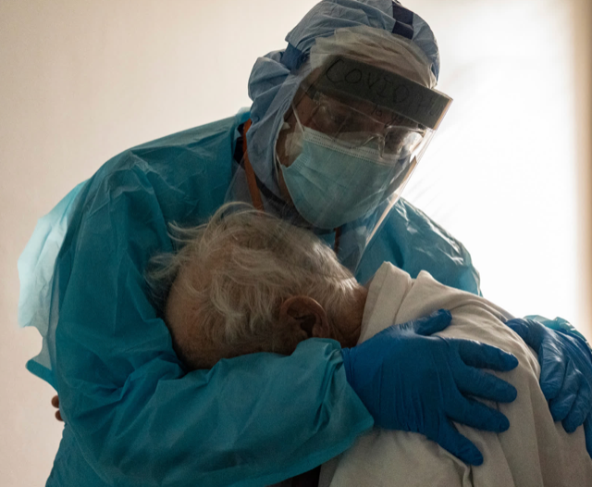
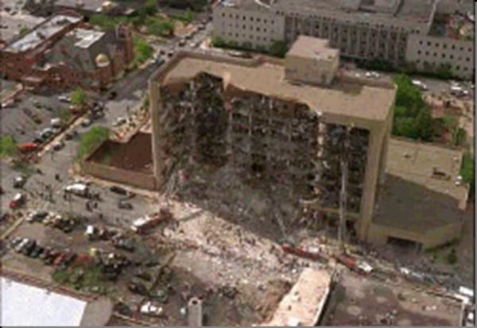
Types of Disaster
Natural
Man-made
Technological
Intentional
Basic Disaster Preparedness
Notes:
Mt Etna, Chernobyl, Oklahoma City

Slide 4

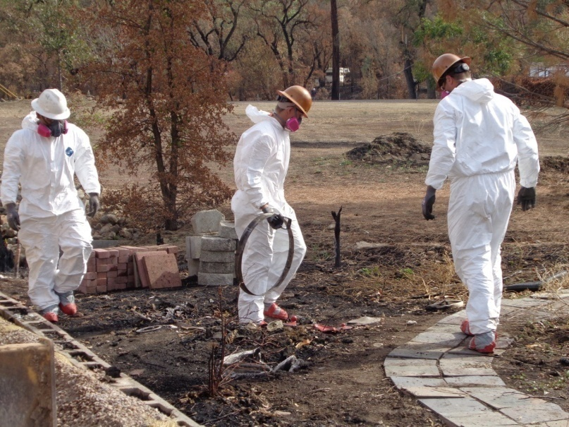
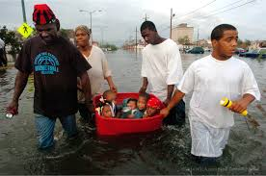
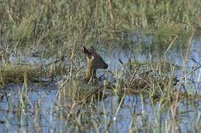


Key Disaster Elements
They are unexpected, even if anticipated
Emergency personnel may be overwhelmed
Lives, health, and the environment are endangered
Basic Disaster Preparedness
Notes:
Oroville shelter, Katrina, Katrina

Slide 5

What Can Happen in Berkeley?
Identify most common disasters that occur
Identify possible hazards with the most severe impacts
Consider recent or historical impacts
Identify susceptible locations in the community for specific hazards
Consider what to expect from disruption of services
Basic Disaster Preparedness

Slide 6
City of Berkeley
Local Hazard Mitigation Plan
2019
www.Berkeleyca.gov/mitigation

Slide 7
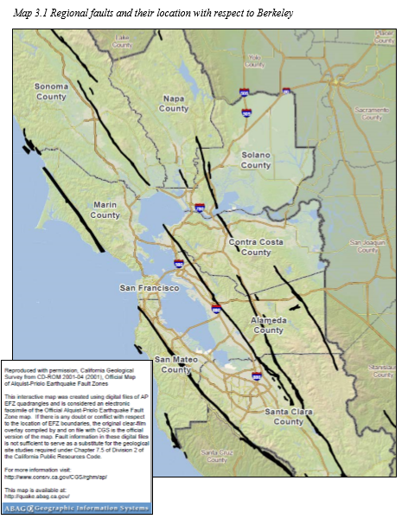
Regional Faults

Slide 8
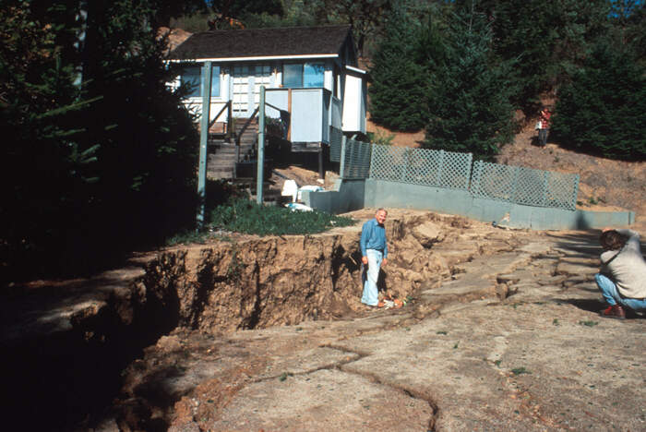
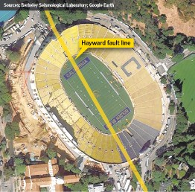
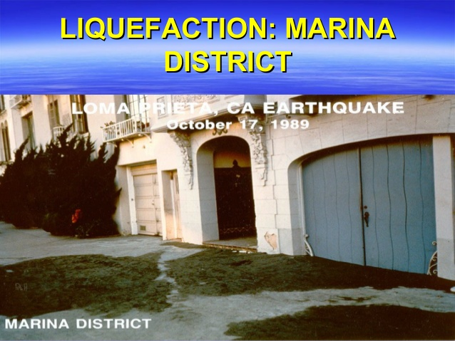
Some Examples of Hazards in Berkeley
Basic Disaster Preparedness
Notes:
Arrows show direction of Rt Lat Strike-slip

Slide 9
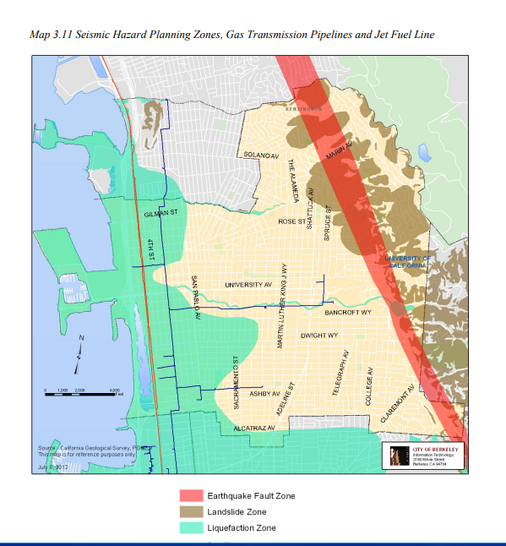

Slide 10
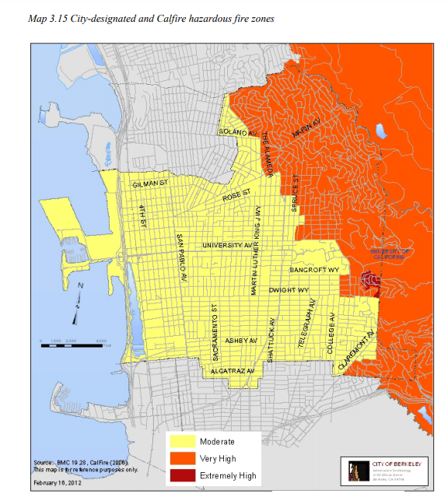

Slide 11
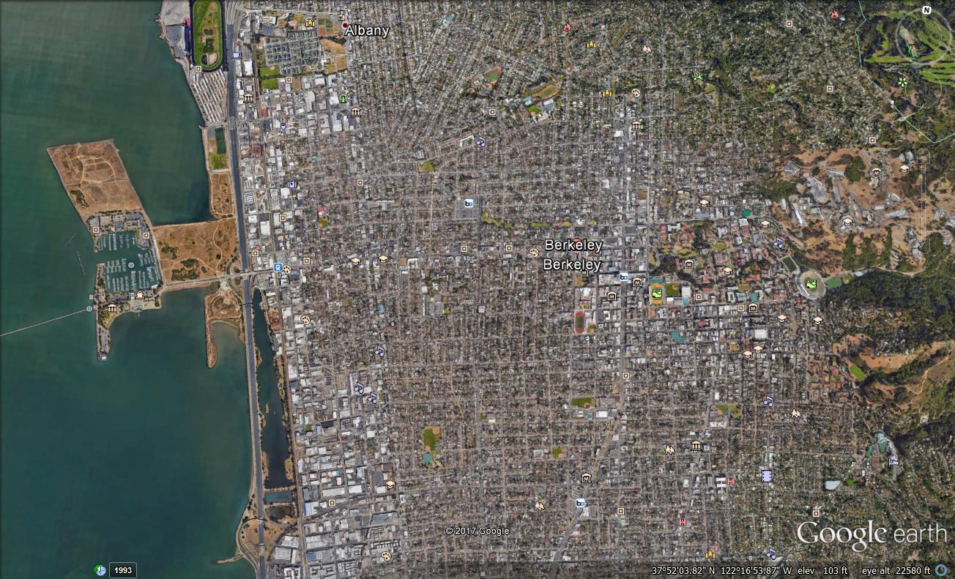
Can you identify other sources of hazards?

Slide 12

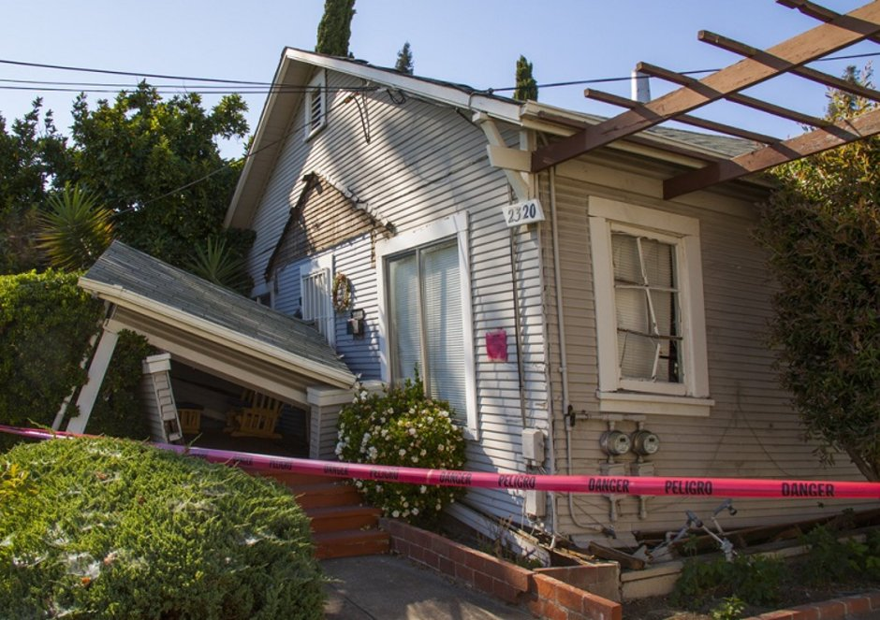
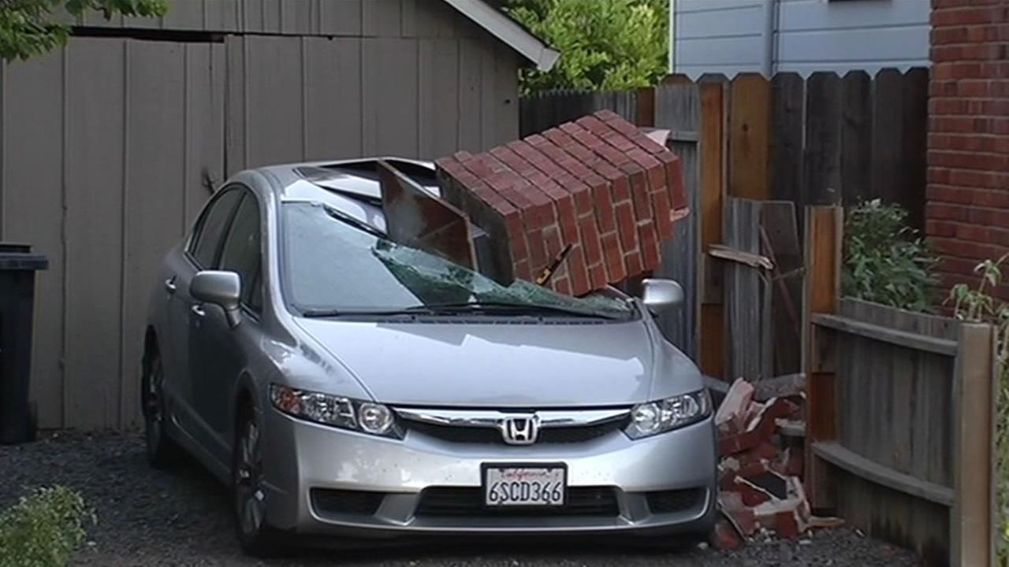
Earthquake Damage
Collapsed buildings
Damage to utilities, structures, and roads
Fires and explosions (gas and oil pipelines, chemical plants, industry)
Basic Disaster Preparedness
Notes:
Napa: Chimneys, twist off foundation

Slide 13
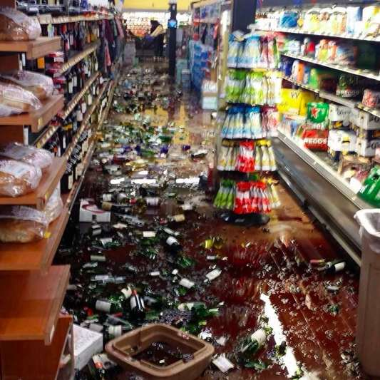
OMG! Could be Bev Mo, Target, Ledgers…
Basic Disaster Preparedness
Notes:
NAPA!

Slide 14
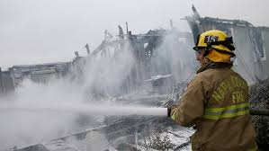
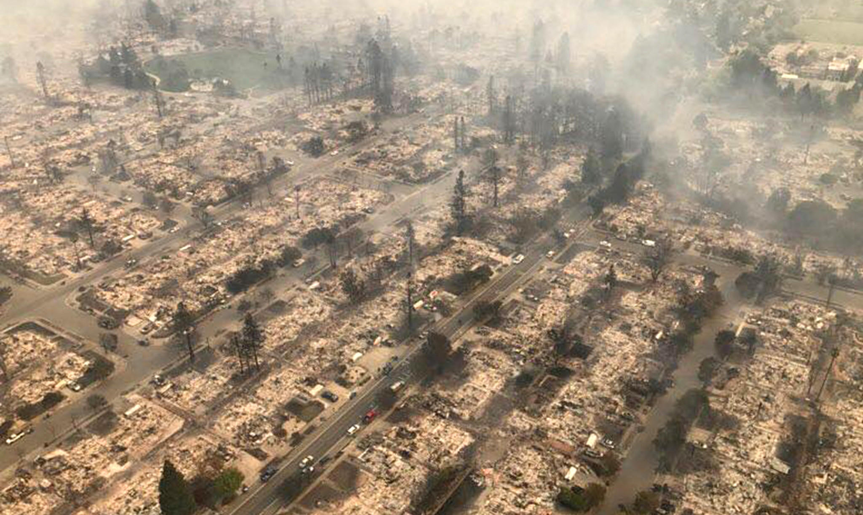
Fire: Man-made or natural causes
Basic Disaster Preparedness
Notes:
Napa

Slide 15
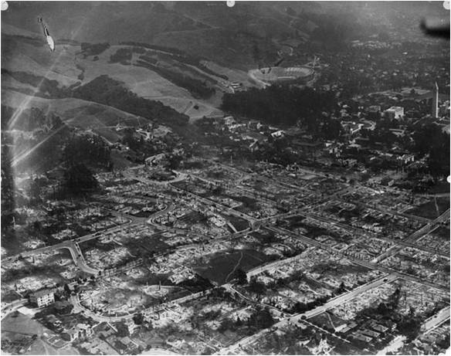
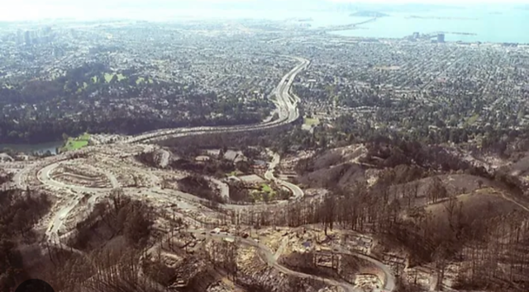
Berkeley 1923
Berkeley/Oakland Hills
Fire - 1991

Slide 16
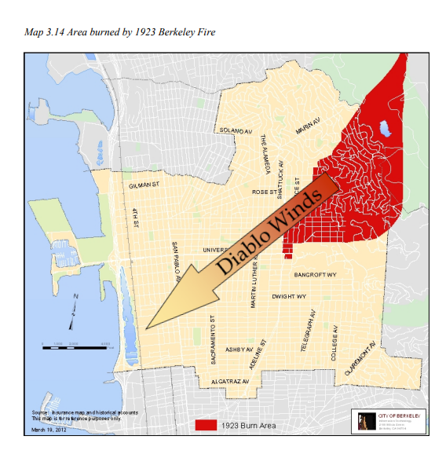

Slide 17
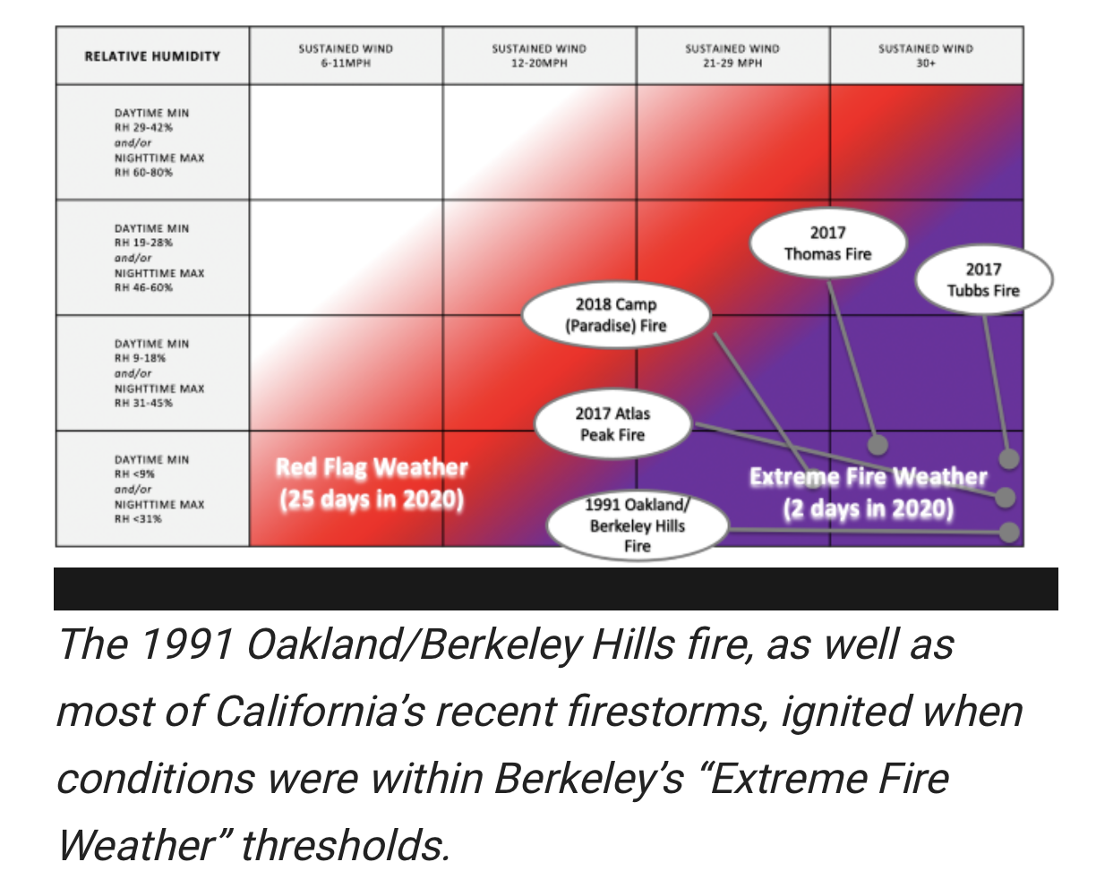

Slide 18
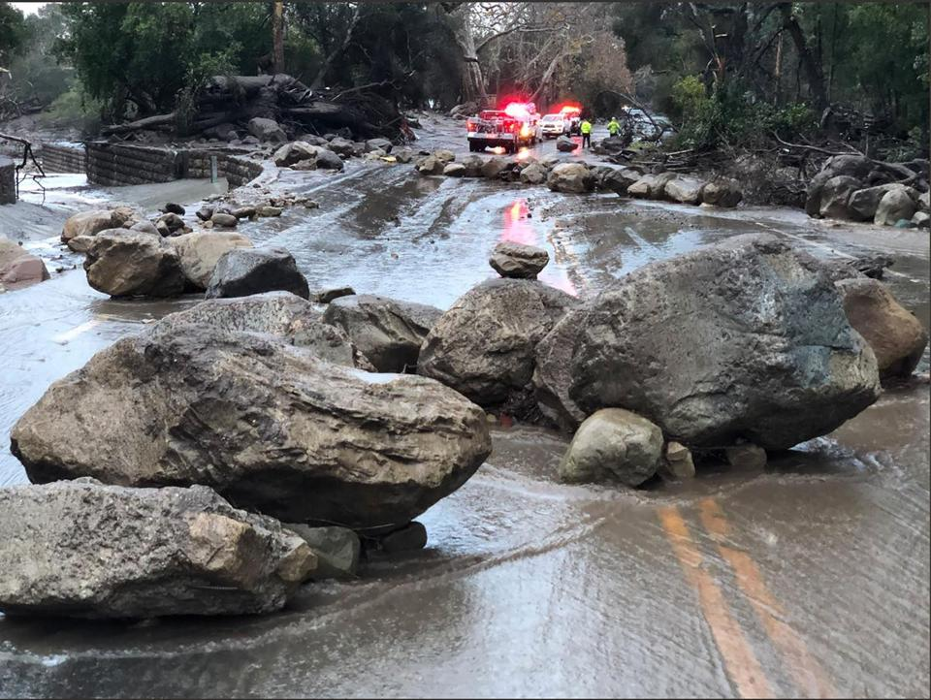
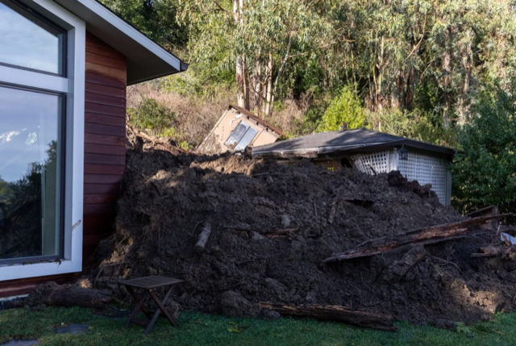
Landslides and Debris Flows
Montecito, California 2018
Berkeley Hills, 2023

Slide 19
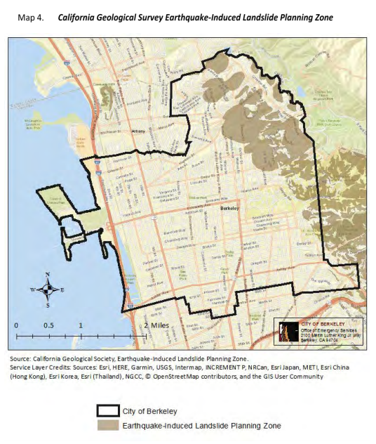

Slide 20
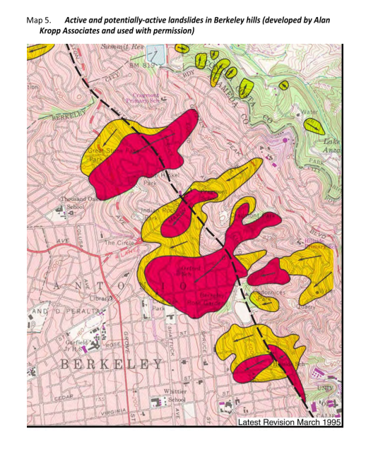

Slide 21
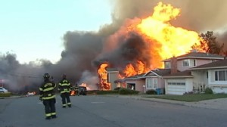
Gas line rupture

Slide 22
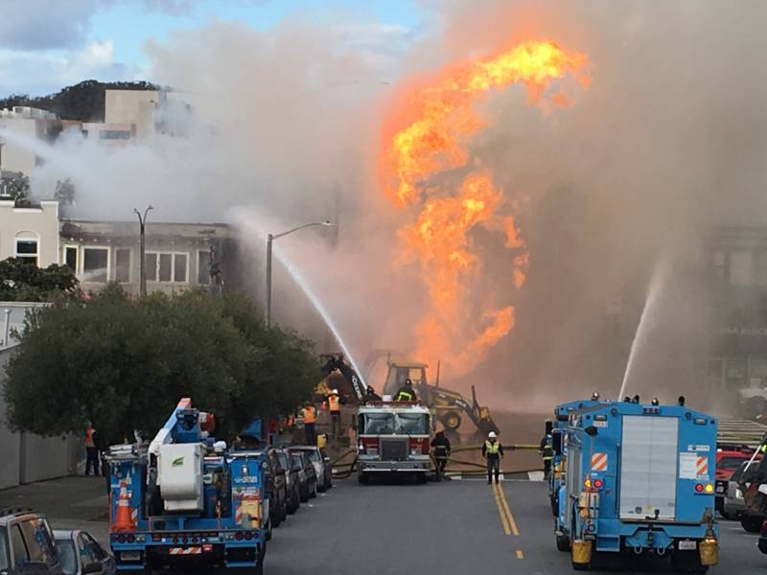
San Francisco 2019

Slide 23

Preparing for a Disaster – ‘Before’
Know local hazards, warning
systems, and evacuation routes. Sign up for alerts.
Implement important elements of disaster preparedness
Address specific needs for yourself and
people you know
Basic Disaster Preparedness

Slide 24
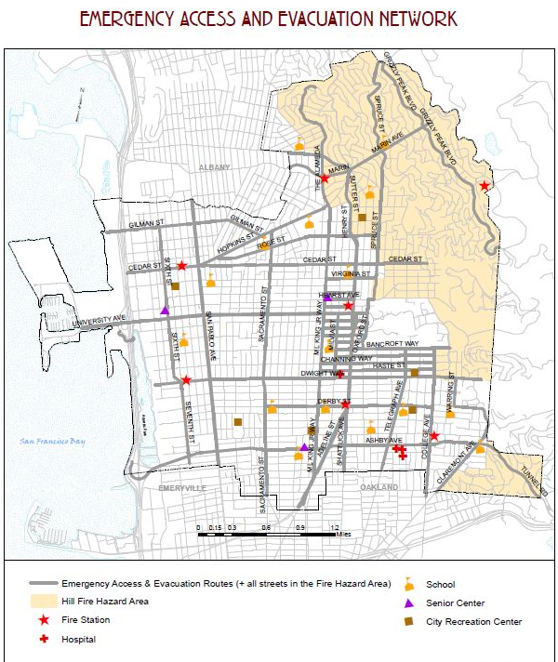


Evacuation Map
If you feel threatened, leave immediately. Do not wait for an evacuation order.
Evacuation web page:
https://www.Berkeleyca.gov/WildfireEvacuation/
Berkeley Path Wanderers:
https://www.berkeleypaths.org/
Zonehaven:
https://aware.zonehaven.com

Slide 25

Disaster Preparedness – ‘Before’
Develop home and work plans for earthquake and other disasters
- plan for reuniting family members
- family communication plan
Keep supplies on hand (Water – Food – Shelter - First Aid)
Conduct drills – practice, practice…
Basic Disaster Preparedness

Slide 26
Make a Disaster Plan
    How will my family/household get emergency alerts and warnings?
    How will my family/household get to safe locations for relevant emergencies?
    How will my family/household get in touch if cell phone, internet, or landline doesn’t work?
    How will family/household get to a meeting place after the emergency?
Basic Disaster Preparedness

Slide 27
Additional questions…
Who is your out-of-State “check-in” contact?
Have you considered needs of children and individuals with disabilities?
Will you have an extended stay outside your home?
Will you shelter in place?
What route(s) will you use if you have to evacuate your neighborhood?
Do you have transportation?
Do you practice your plan?
Basic Disaster Preparedness

Slide 28

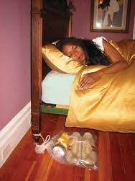
Home Earthquake Preparedness 1
Store heavy and breakable objects on low shelves
Move beds away from windows if possible
Move or secure hanging objects over beds, sofas, or chairs
Keep shoes and flashlight under bed
(accessible)
Fire extinguishers (at appropriate locations)
Working Smoke alarms!
Basic Disaster Preparedness

Slide 29
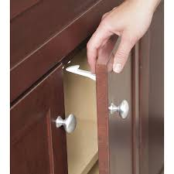
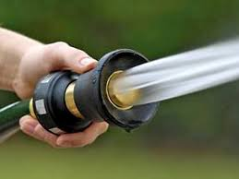
Home Earthquake Preparedness 2
Anchor heavy furniture and appliances
Childproof cabinet doors
Locate and label gas, electricity,
and water shutoffs
Secure water heaters and
consider automatic gas shutoff valves
Garden hose nozzle for small fires
Supplies for house and go-bag(s)
Basic Disaster Preparedness

Slide 30
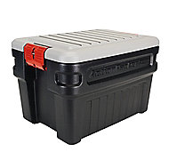
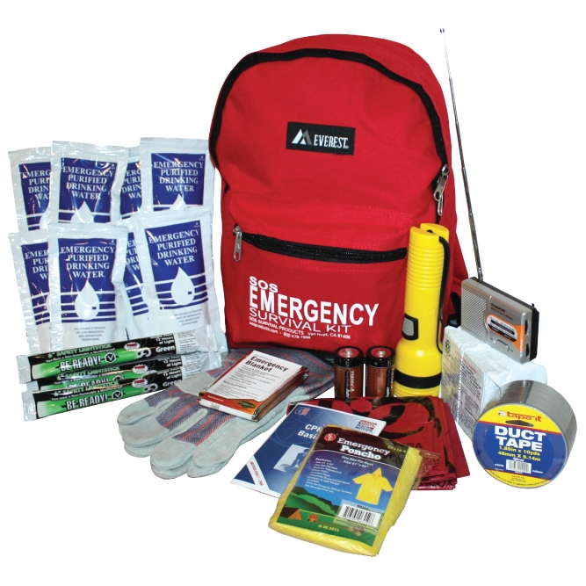
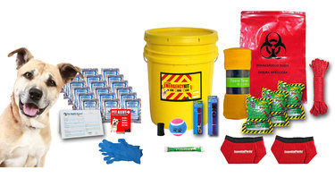
Emergency Kits - Go and Stay
Check list from City of Berkeley Emergency Preparedness
brochure
Basic Disaster Preparedness

Slide 31
Emergency supplies
Water – Water – Water Personal medication
Non-perishable Food Supplies for children
Can opener ( or cans with a pop top) Assistance Devices
Radio (with batteries, solar, or crank) Extra Clothes/shoes
Flashlight (batteries and/or solar) Paper and writing device
Cell phone (charger) Games
First aid Kit (assortment of items) Other things?
Emergency shelter and blankets
Cash in small bills
Personal hygiene products (travel size)
Multi-purpose Tools/ wrench
Documents (Hard copies, flash drive, in the cloud, with family)
Camping supplies
https://berkeleyca.gov/safety-health/disaster-preparedness/preparedness-resource-library

Slide 32
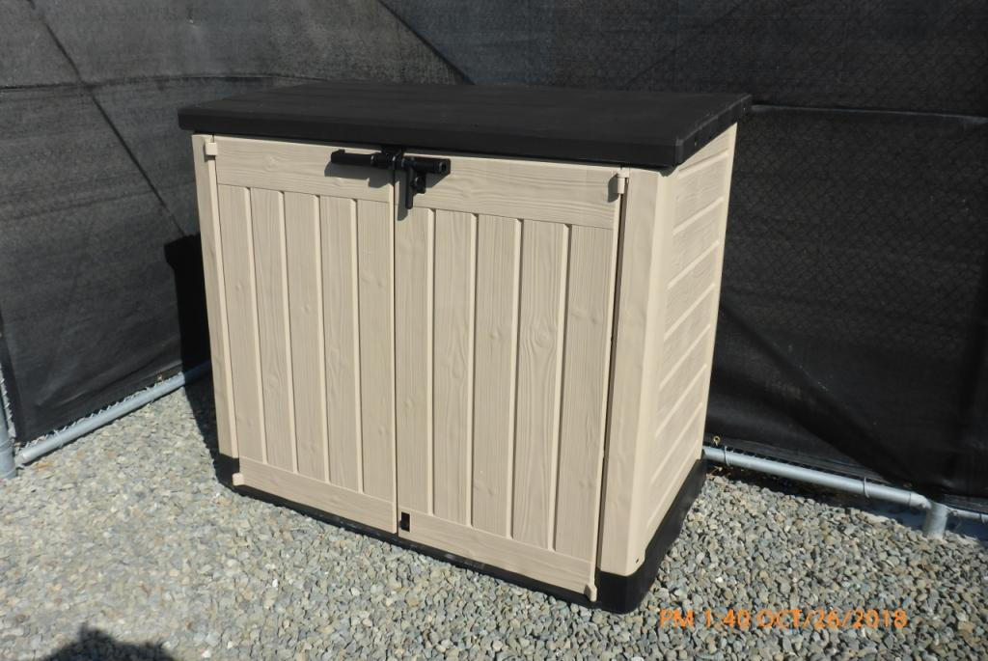
Outdoor storage bin

Slide 33
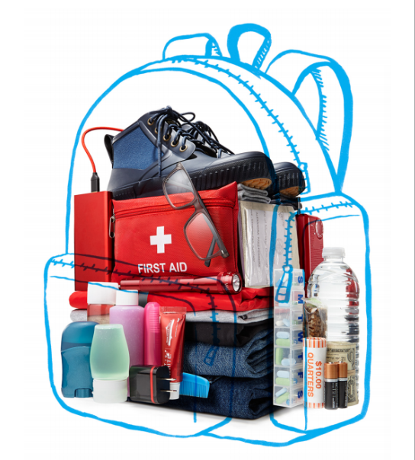
Go Bag (from AARP)

Slide 34


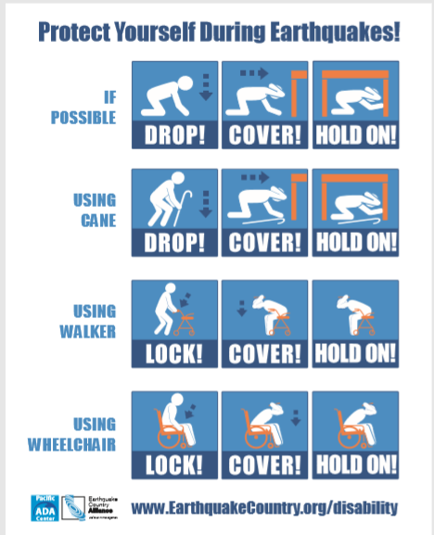
During an Earthquake – Drop, Cover, Hold… or…?
Basic Disaster Preparedness

Slide 35


After an Earthquake
First:
  Check yourself and family for injuries,
and protect yourselves from further danger
  Assess your mental state
  Check utilities (gas, electricity, water) if applicable
Basic Disaster Preparedness

Slide 36
After the earthquake – step 2
Then:
  Do a home assessment (extinguish small fires-inspect home for damage, clean up spills or glass)
  Text your out-of-area contact - periodically, but don’t overdo it!
  Expect aftershocks – have your go-bag ready
  Help neighbors (use your CERT training!)

Slide 37


Stay Informed
Sources of Emergency Information
  Sign up at www.ACAlert.org to receive emergency messages for Berkeley and jurisdictions across Alameda County. (BENS is deactivated.)
  Listen to radio (Berkeley:1610 AM; Bay Area: KCBS, KQED, KSOL, KPFB) (remember cars have radios too)
  TV (Broadcast stations)
  Websites
  Social Media/Nixle/NextDoor
  Your Neighbors
For More Information:
http://www.cityofberkeley.info/EmergencyAlerting/
Basic Disaster Preparedness

Slide 38
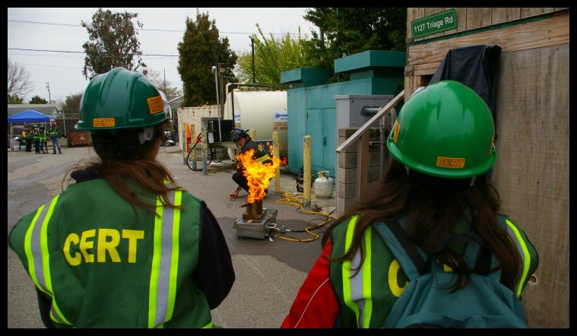
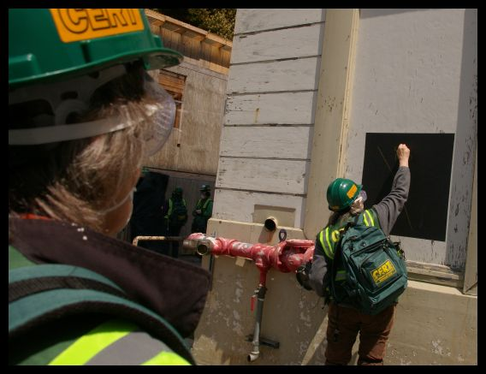
City of Berkeley CERT Training - FREE
1. Disaster Preparedness
2. CERT Organization
3. and 4. Disaster Medical Operations (1&2)
5. Disaster Psychology
6. Fire Safety and Utilities
7. Light Search and Rescue
8. Terrorism and CERT
Basic Disaster Preparedness

Slide 39
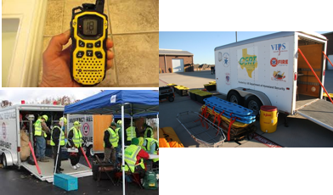
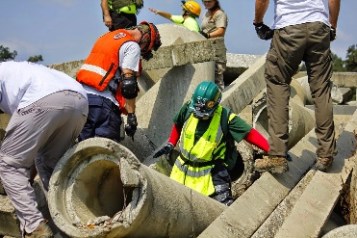



CERT Incident Command System
First person to arrive on scene or at the command post.
Incident Commander
Operations
Logistics
Planning
Finance & Admin
Text
Tracks Costs and Time
Directs & coordinates all tactical ops
Communication, supplies and facilities
Resources, situation status, action plans, & documentation
e
Notes:
1 - The FIRST person to arrive at the command post must establish Incident Command (IC). If this does not occur and the person assigns themselves a task, then leaves the command post and then several other responders perform in the same way, you have no foundation to build your incident response from, you have responders who are freelancing, working without accountability and ultimately it will take longer (if you ever are able to) recover and implement an effective incident management system.
2 - Operations - Task masters. Operations is tasked with directing all actions to meet the incident objectives.
3 - Logistics - Logistics is tasked with providing all resources, services, and support required by the incident.
4 - Plans - The "information sponge". Planning is tasked with the collection and display of incident information, primarily consisting of the status of all resources and overall status of the incident.
5 - Finance - The money "men". Finance is tasked with tracking incident related costs, personnel records, requisitions, and administrating procurement contracts required by Logistics.

Slide 40
Additional Training Opportunities
First aid, CPR, Automated External Defibrillator (AED)
Pet Preparedness
Pandemic
STB (stop the bleed)
Shelter management (Red Cross)
Traffic/crowd management
Utilities control (PGE)
Flooding preparedness
www.ready.gov/citizen-corpstraining/fema-independent-study-courses
Youtube videos, other sources
Basic Disaster Preparedness

Slide 41
CERT Size-up
Gather Facts
Assess Damage
Consider Probabilities
Assess Your Situation
Establish Priorities
Make Decisions
Develop Plan of Action
Take Action
Evaluate Progress
REMEMBER: CERT SIZEUP IS A CONTINUAL PROCESS

Slide 42
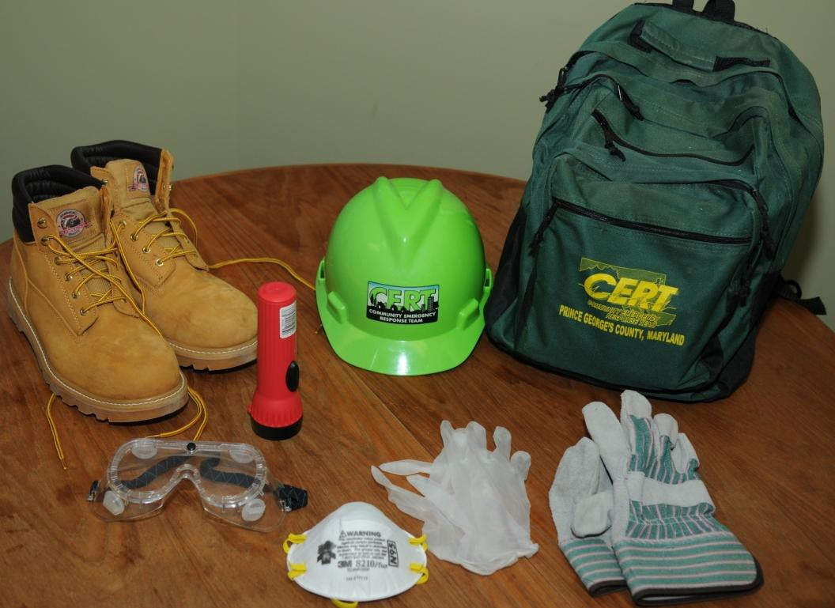
Obtain Personal Protective Equipment
Hard Hat
Goggles
N95 Mask
Gloves (work and nitrile)
Sturdy shoes or work boots
Safety vest
Basic Disaster Preparedness

Slide 43
Getting involved in CERT
Training provides skills needed to help others and keeps skills current
  CERT program provides training, practice, and connection to others
  Participate in drills and exercises
  Talk to friends and family about volunteering

Slide 44
CERT Disaster Response
Your first responsibility is personal and family safety
Respond in the period immediately after a disaster
Assist emergency response personnel when requested to do so by them
  Locate and turn off utilities, if necessary and safe
  Set up ICS
  Extinguish small fires
  Treat and triage injuries
  Conduct light search and rescue
  Help to relieve survivor stress
Do the most good for the most people in the shortest time
Basic Disaster Preparedness

Slide 45

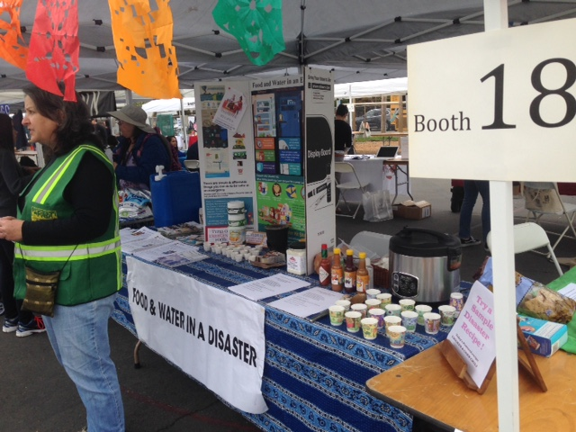
Non-Disaster Roles of CERT
Identify and aid neighbors who might need assistance getting prepared
Distribute preparedness materials; do demos
Staff booths at special events
Basic Disaster Preparedness

Slide 46

Get Involved in CERT
Preparedness requires active participation from all
  Talk to friends and family about hazards and disaster planning in your neighborhood
  Make sure those in charge have a plan
Basic Disaster Preparedness

Slide 47
Everyone
Learn about community alerts, warnings, and evacuation routes
Make a personal plan
Take training
Practice skills and personal plans
Network and help others in your community
Volunteer for CERT
Basic Disaster Preparedness

Slide 48
Questions
Thank you and be safe.
Please do 1 thing today or this week to help prepare yourself and your family.
Carrie Dovzak
FD1 CERT District Coordinator
cdovzak@cityofberkeley.info
Leah Greenbaum
City of Berkeley Emergency Services Coordinator
Lgreenbaum@cityofberkeley.info
Basic Disaster Preparedness

